Slide 1
CAPSTONE Project Assessing the attractiveness of opening an Italian restaurant in India
Abhiram R Devesh
12th August 2020

Slide 2
Background
The year is 2021, the year after the deadly pandemic that brought the world to a standstill. The pandemic had made every business across the world to rethink their strategy in terms of their expansion plans and market entry.
It was the similar story at Pasta Tales Inc., a leading chain of Italian cuisine restaurants based out of the United Kingdom.
In early 2020, the top management had decided to enter the Indian market and wanted to open at least 3 restaurants across the country.
The company had decided all the locations and as they were about to roll-out the plan to enter the market, the pandemic hit the world.
Because of the pandemic, the board of directors at Pasta Tales Inc. decided to revisit their Indian market entry strategy and had asked the COO to come up with an analysis of relevant data points to back their decision of entering the Indian market with 3 restaurants.

Slide 3
Breakdown of the problem
Identify the number of restaurants in each city followed by number of restaurants catering to Italian cuisine across India
Understand the distribution of restaurants across various localities based on the cuisine in the cities of focus
Identify the number of establishments that are catering to the Italian cuisine along with alcohol and plot the same
Understand the cost distribution of the restaurants catering to Italian cuisine in a particular city
Key features that have to be part of the restaurant

Slide 4
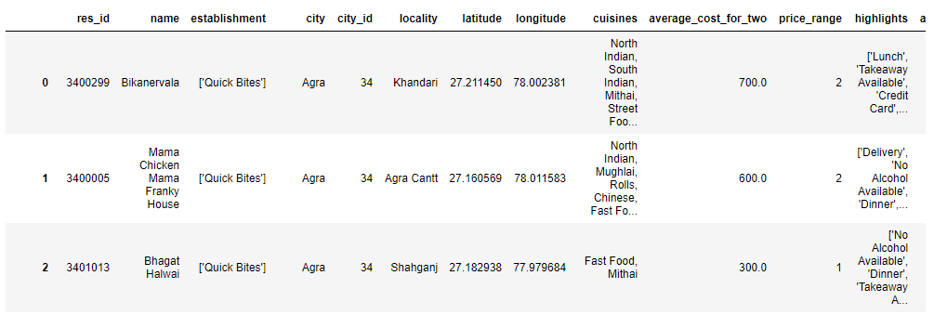
Data Source
Dataset relating to the restaurants/eateries in India was accessed from Kaggle. The dataset was scraped from Zomato, a leading restaurant/food delivery aggregator in based in India. The dataset was last updated in the year 2019.

Slide 5
Data Description
Name – Name of the establishment
Establishment – Type of establishment (26 various types of establishments viz. Bakery, Casual dining, Bar, Pub, Quick Bites)
City – Location of the restaurant
Locality – Details of the area within the city
Latitude – Co-ordinates
Longitude – Co-ordinates
Cuisines – Type of cuisine catered to by the establishment
Average Cost For Two
Highlights – Key tags for the establishment (E.g. Takeaway, Valet available, Non-Smoking, Serves Alcohol etc.)
Aggregate Rating – Rating for the establishment; Rated out of 5 (1 being “Poor”, 5 being “Excellent”)
Rating Text – Text attributed based on the rating (1 being “Poor”, 5 being “Excellent”)
Votes – Total number of votes for that establishment given by the users of Zomato

Slide 6
Data Cleanup
Converted the data types for select variables such as Latitudes, Longitudes, Average Cost for Two and Aggregate Rating
There were duplicate entries of many restaurants (Having the same location coordinates). These were removed to avoid bias in any of the analysis
Data under the columns “Rating Text” and “Votes” were not used for the current analysis
Data with empty fields were dropped from the data frame
Variable | Raw Datatype | Converted Datatype | Reason for conversion
Latitude | String | Float with 6 decimal places | For precise plotting on map
Longitude | String | Float with 6 decimal places | For precise plotting on map
Average Cost For Two | String | Integer | For correlation analysis
Aggregate Rating | String | Float with 1 decimal place | For correlation analysis

Slide 7
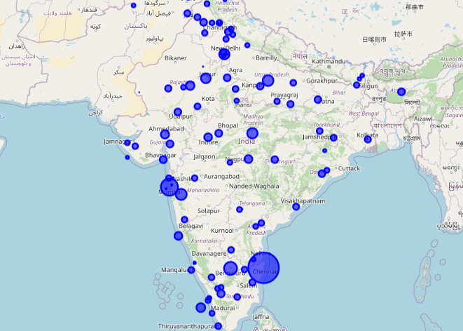
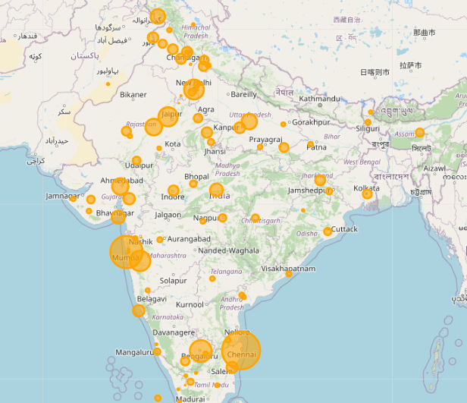
Distribution of Restaurants across India
All Cuisines
Italian Restaurants

Slide 8
Top 5 Cities with Italian Cuisines
From the data we have found the top 5 restaurants in the country
City | No. of restaurants catering to “Italian cuisine” (Nos.)
Chennai | 1871
Mumbai | 1588
Bangalore | 1074
Pune | 1004
New Delhi | 972

Slide 9
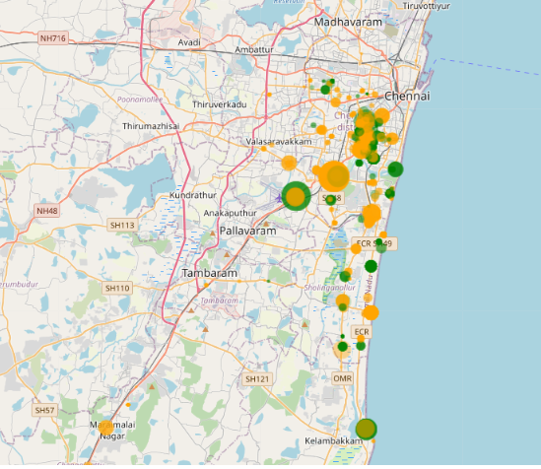
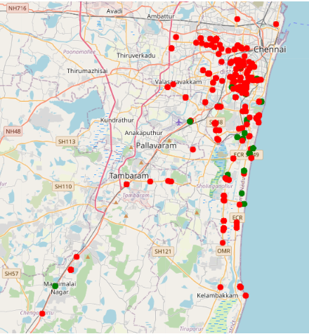
Deep Dive - Chennai

Slide 10
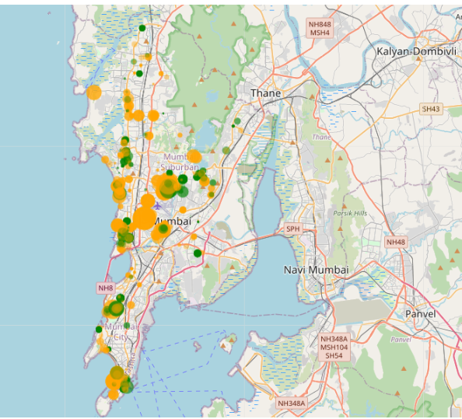
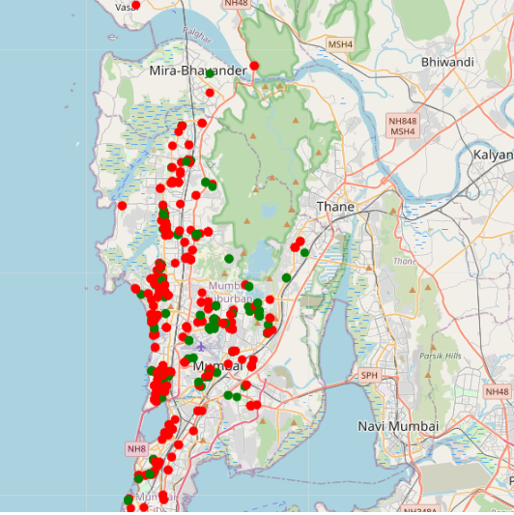
Deep Dive - Mumbai

Slide 11
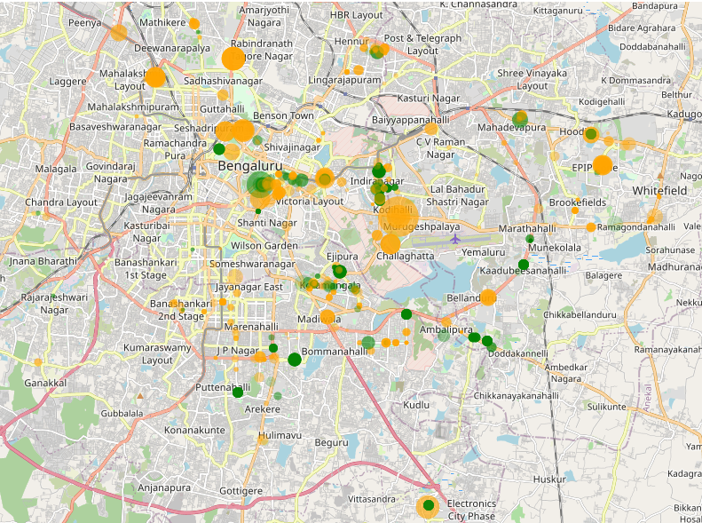
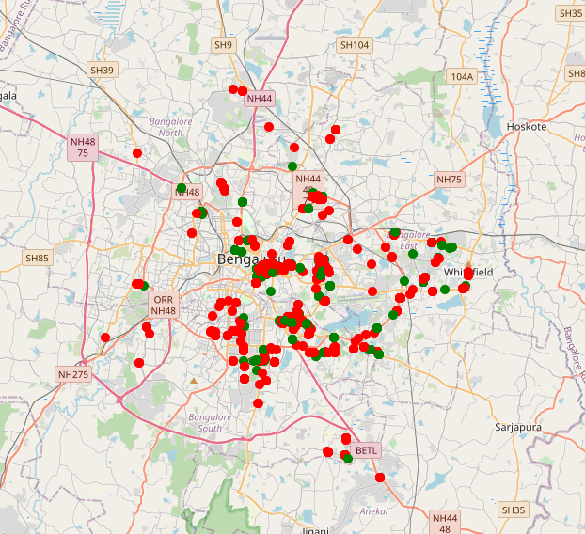
Deep Dive - Bangalore

Slide 12
Conclusion
From this analysis, we can infer that Italian restaurants for the
City of Chennai with All Day Dining options, Free parking and which serves alcohol have good potential in Chennai.
City of Mumbai with only Breakfast and Dinner, and which serves alcohol have good potential.
City of Bangalore with All Day Dining options, and which serves alcohol have good potential,

